Slide 1
Psychologie expérimentale de la mémoire: L’oubli (involontaire)
MIASHS L3 SC
Attention et Mémoire III

Slide 2
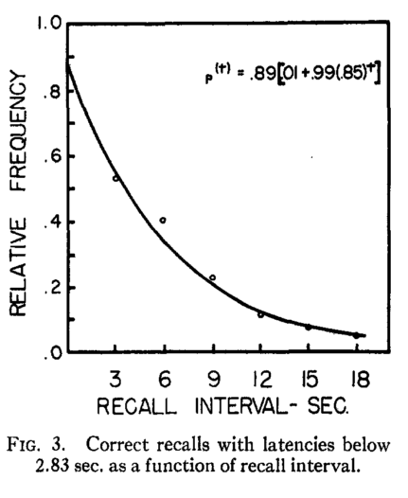
Peterson & Peterson (1969). Journal of Experimental Psychology, 58, 193

Slide 3
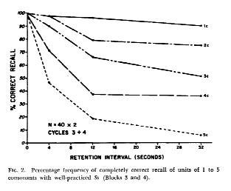
Keppel & Underwood (1962). Journal of Verbal Learning and Verbal Behavior, 1, 153

Slide 4
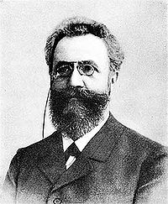
Hermann Ebbinghaus
(1850 – 1909)
Notes:
169 listes de 14 syllabes

Slide 5
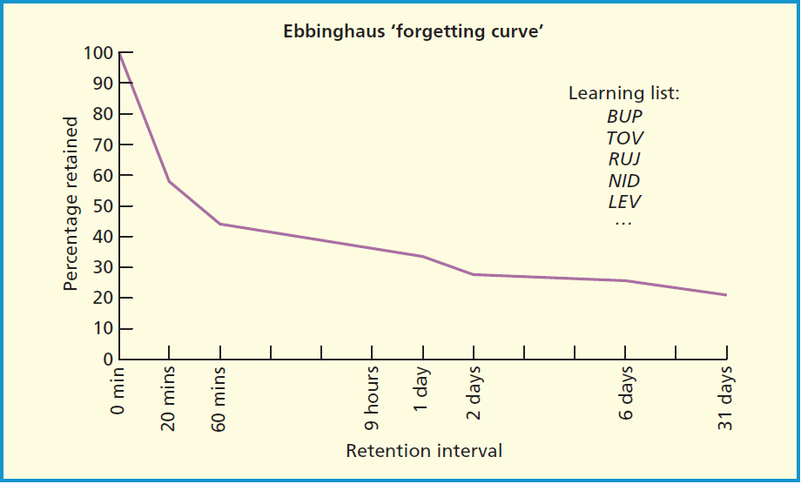

Slide 6
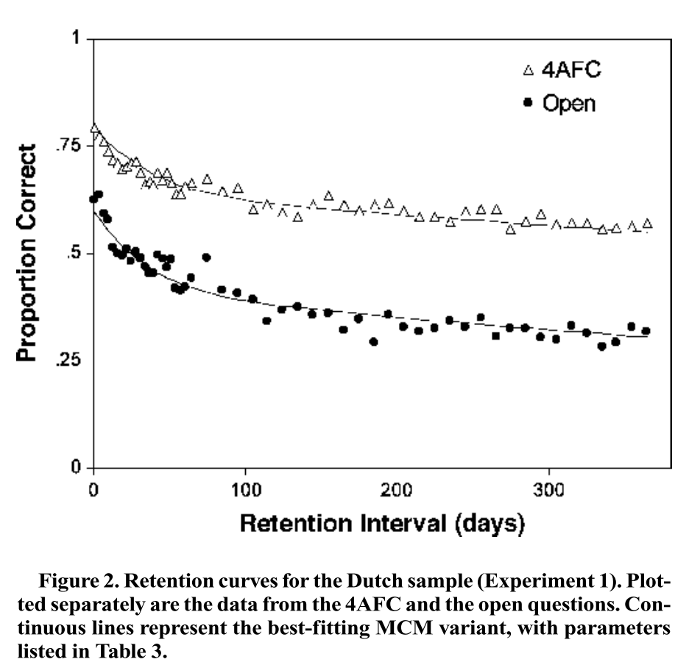
Meeter et al. (2005). Memory & Cognition, 33, 793
Notes:
14000 participants over internet

Slide 7
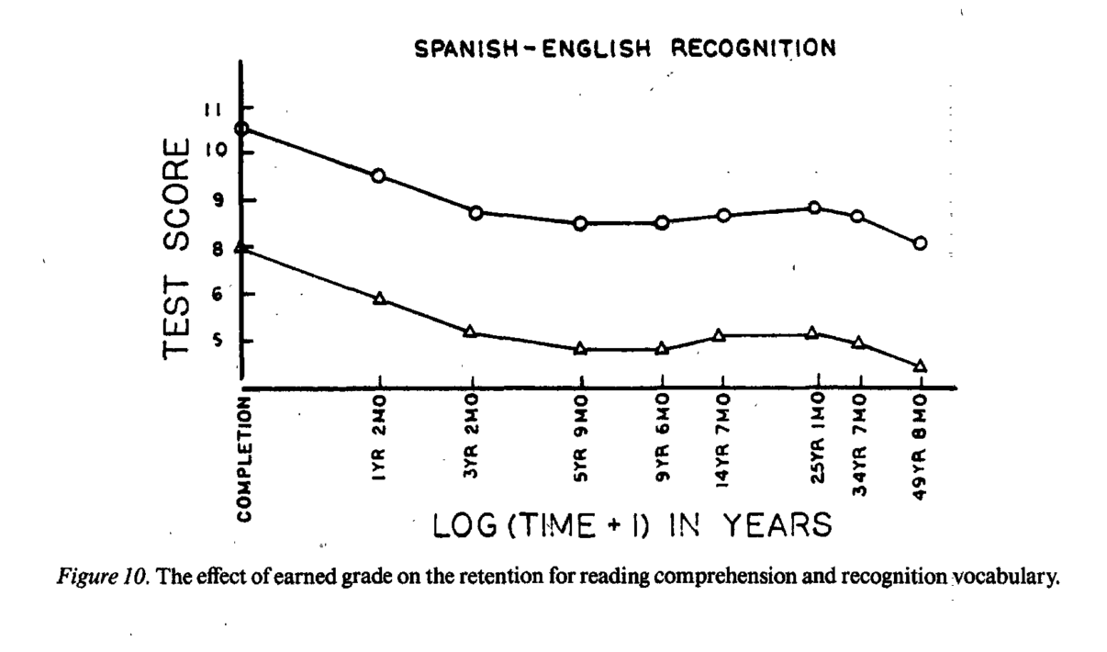
Bahrik (1984). JEP: General, 113, 54

Slide 8
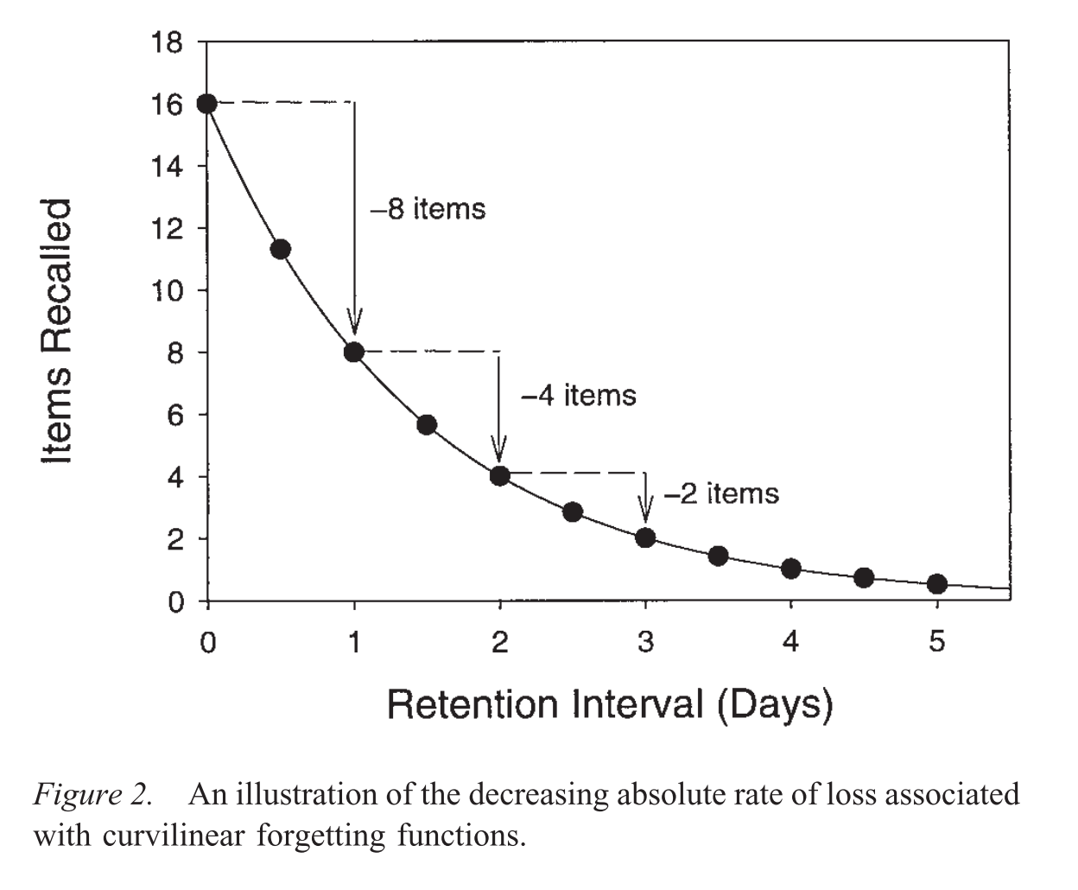

Slide 9
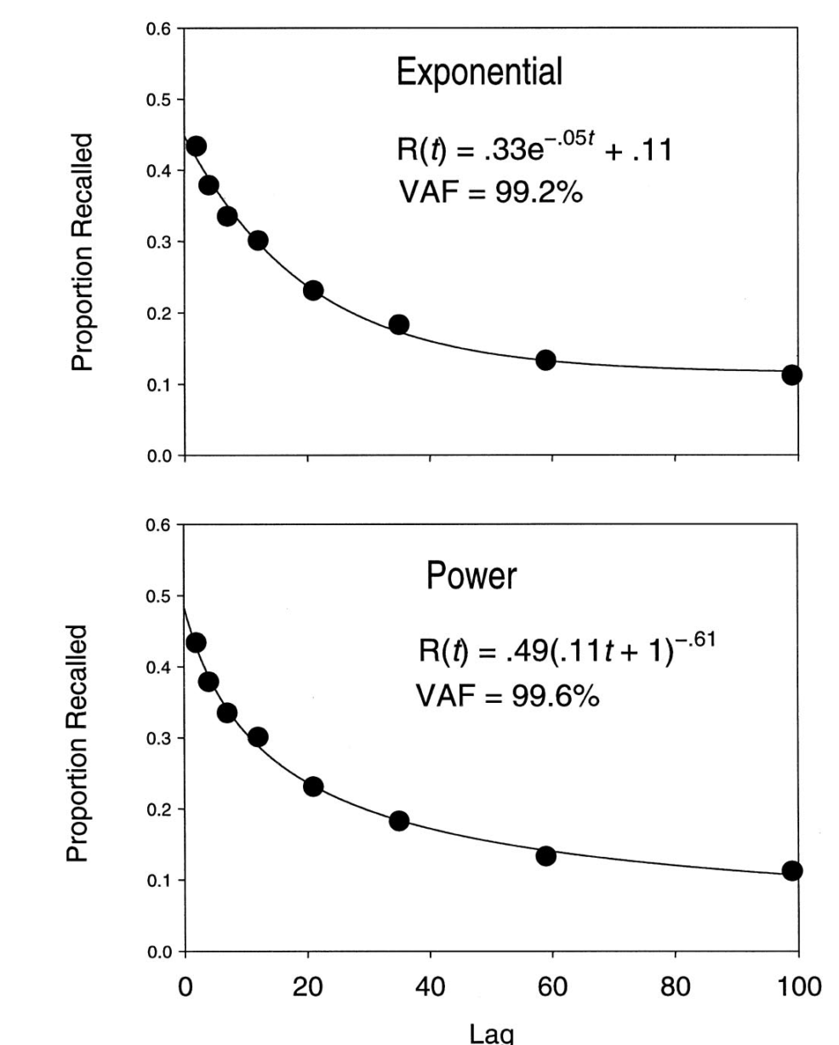
Rubin et al. (1999). Journal of Experimental Psychology: Learning, Memory & Cognition 5, 1161

Slide 10
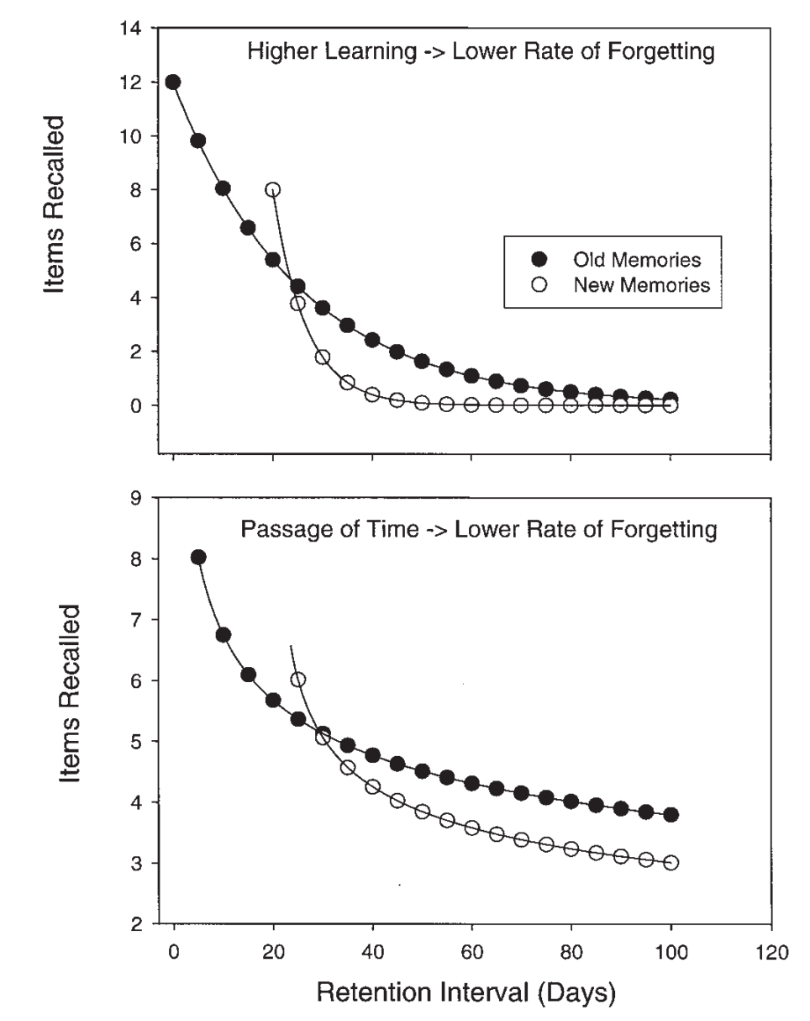
Exponential forgetting
Power forgetting
Notes:
Jost’s law exponential forgetting

Slide 11
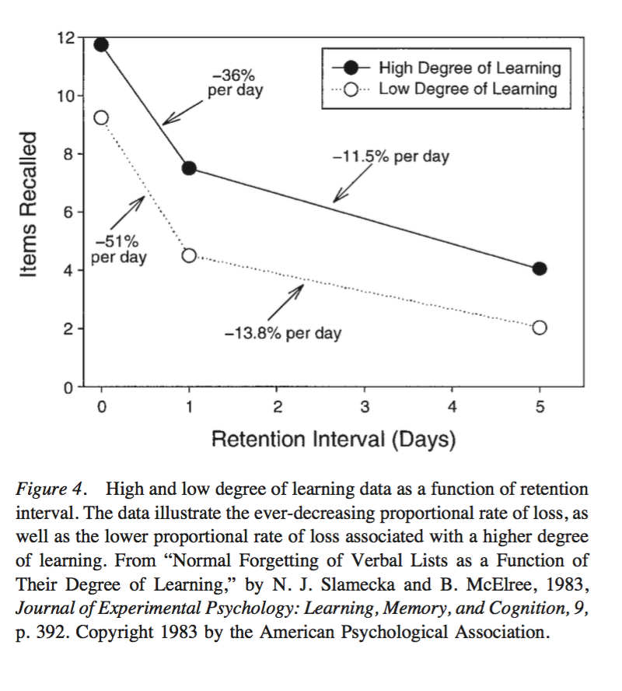
Slamecka & McElree (1983). JEP: Learning, Memory & Cognition, 9, 384

Slide 12
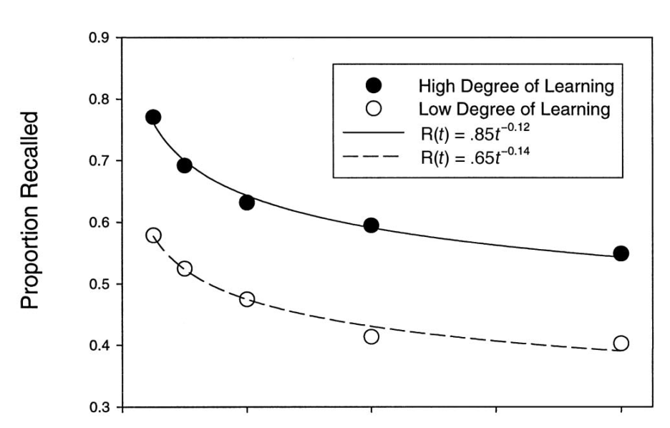
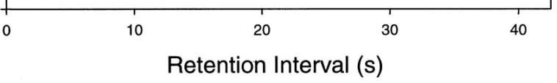
Wixted & Ebbesen (1997). Memory & Cognition 25, 731

Slide 13
Bahrik (1984). JEP: General, 113, 54

Slide 14
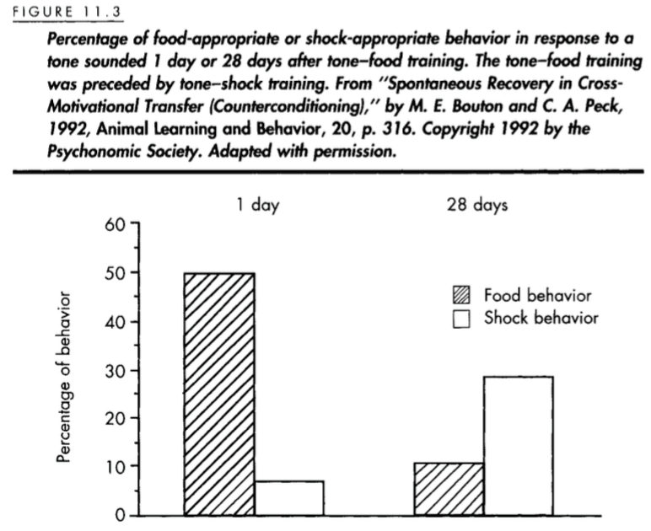

Slide 16
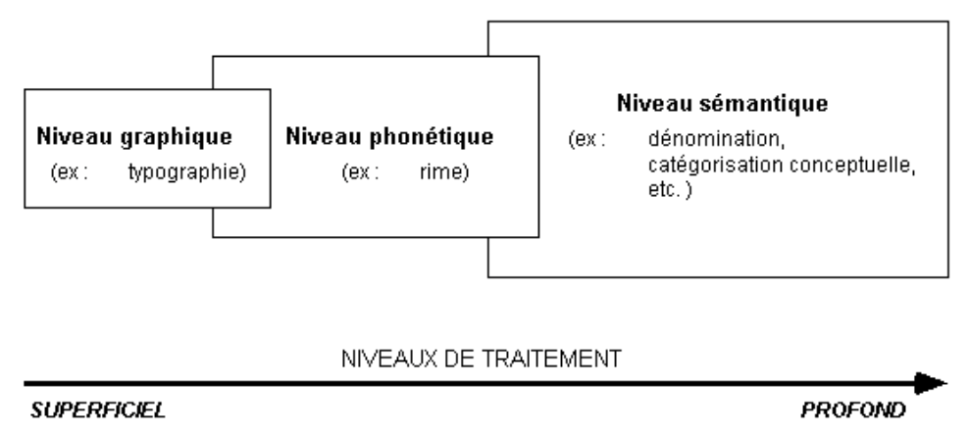
Craik & Lockhart (1972) – THEORIE DES NIVEAUX DE TRAITEMENT

Slide 17
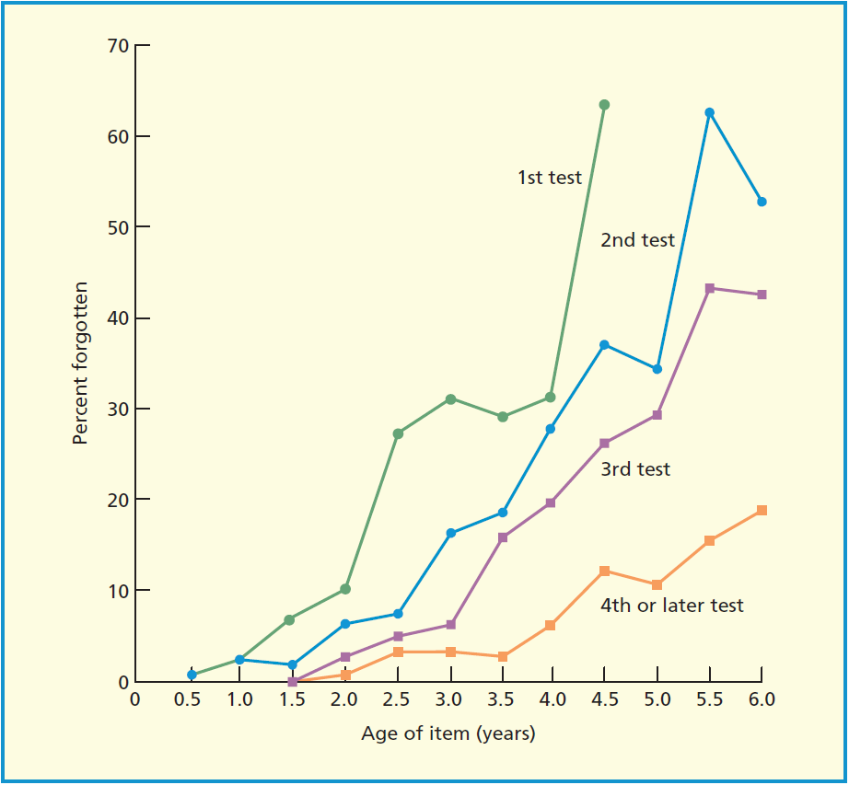
Linton (1975). In Norman & Rumelhart, Explorations in cognition.

Slide 18
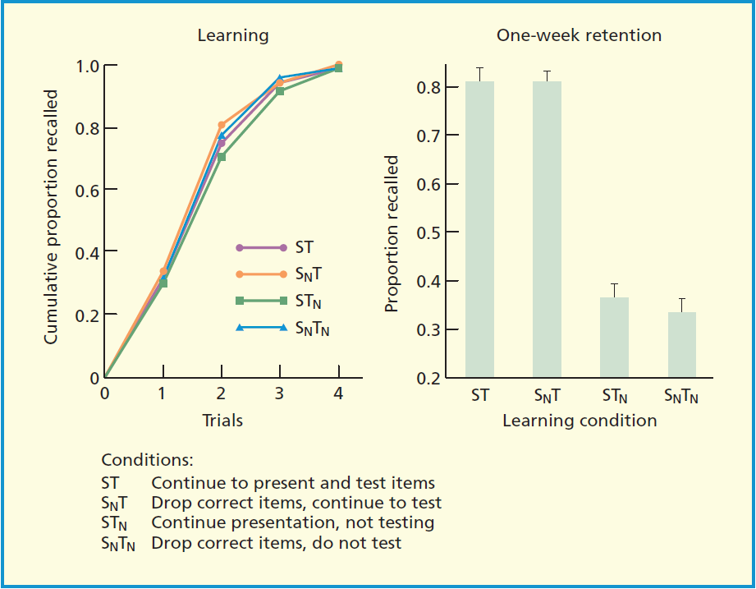
Karpicke & Roediger (2008). Science, 319, 966

Slide 19
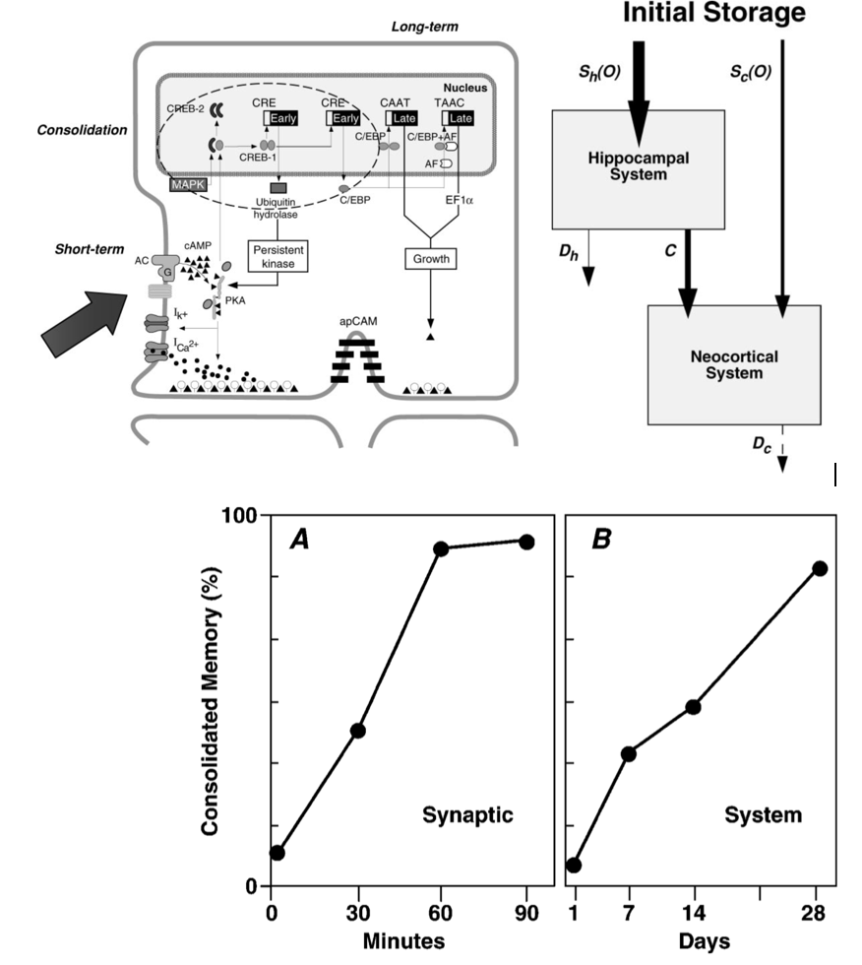

Slide 20
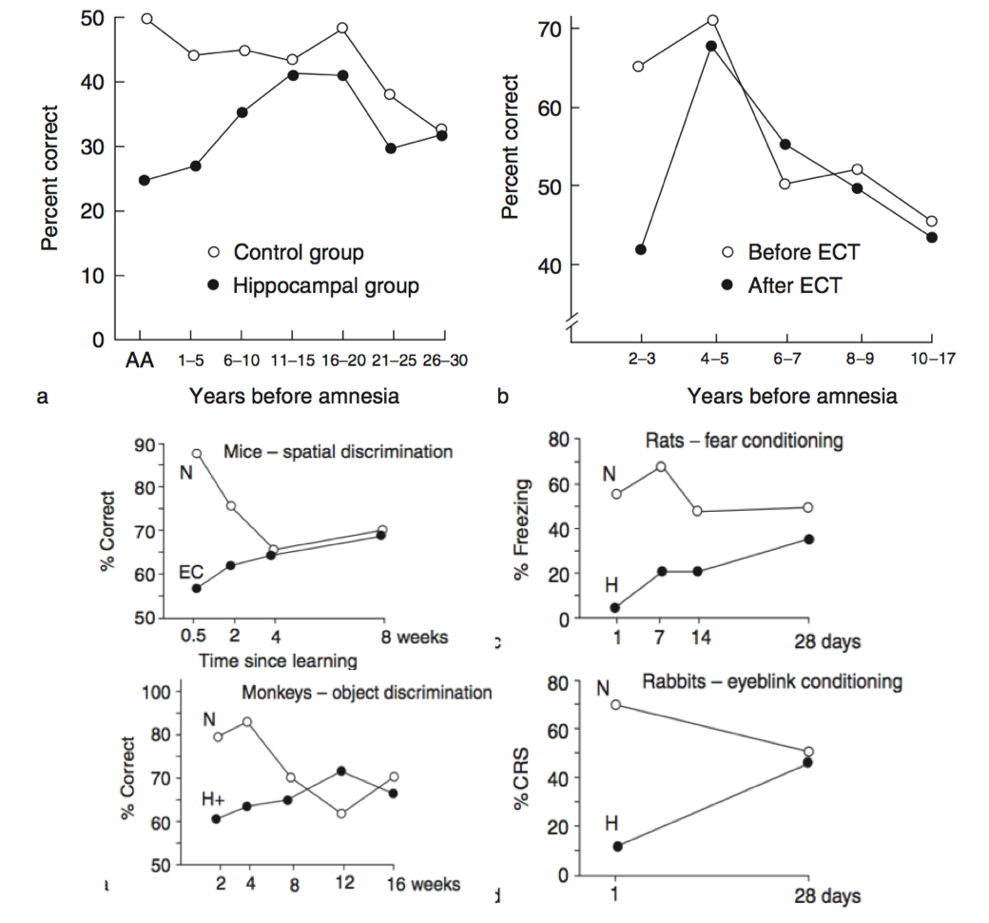
Mann et al. (2003). Neuron, 38, 127
Chase (1975). Science, 187, 77
Cho et al. (1993). Journal of Neuroscience, 13, 1759
Kim & Fanselow (1992). Science, 256, 675
Zola-Morgan & Squire (1990). Science, 250, 288
Kim et al. (1995). Behavioral Neuroscience, 109, 195

Slide 21
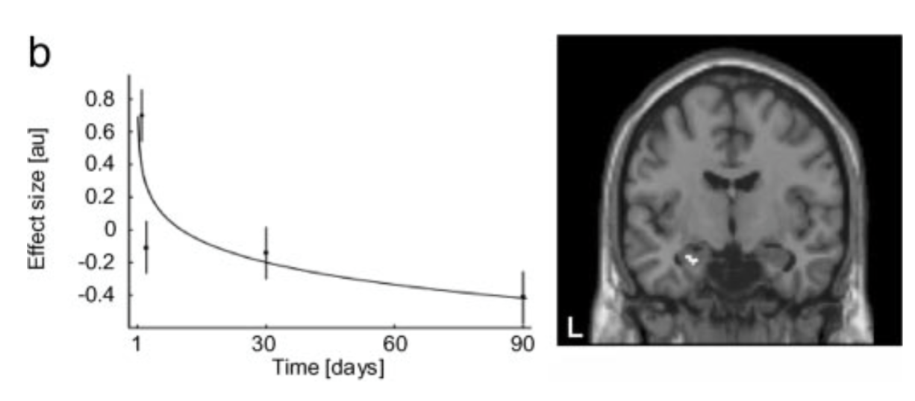
Takashima et al. (2006). PNAS, 103, 756

Slide 22
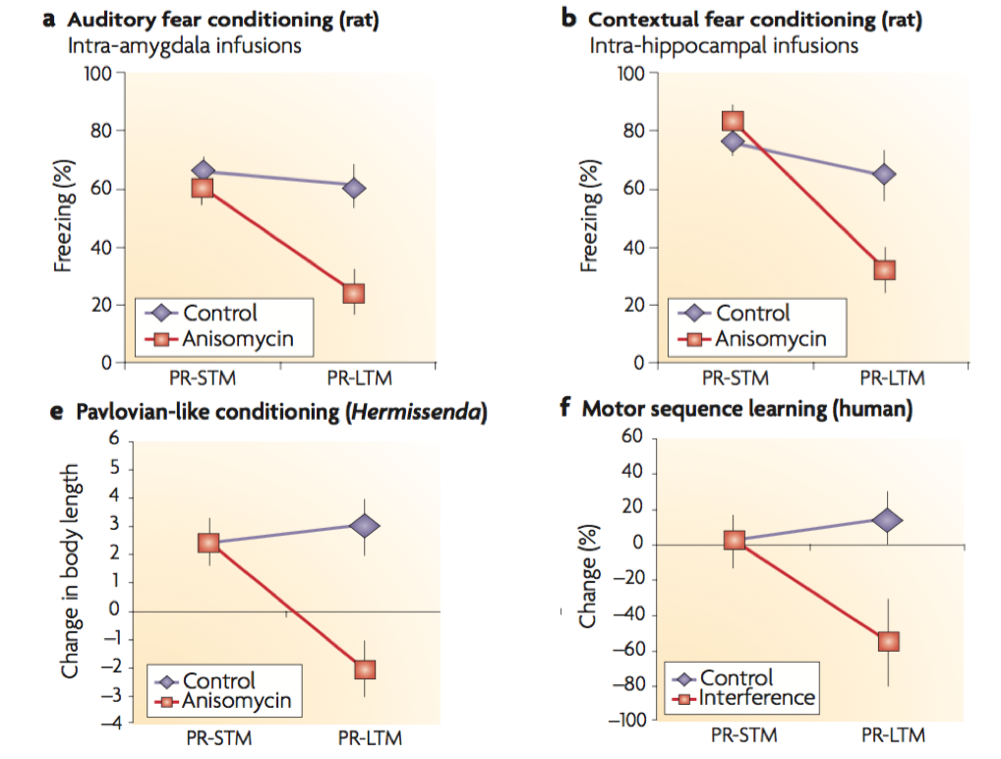
Nader et al. (2000). Nature, 406, 722
Debiec et al. (2002). Neuron, 36, 527
Child et al. (2003). Biological Bulletin, 205, 218
Walker et al. (2003). Nature, 425, 616

Slide 23
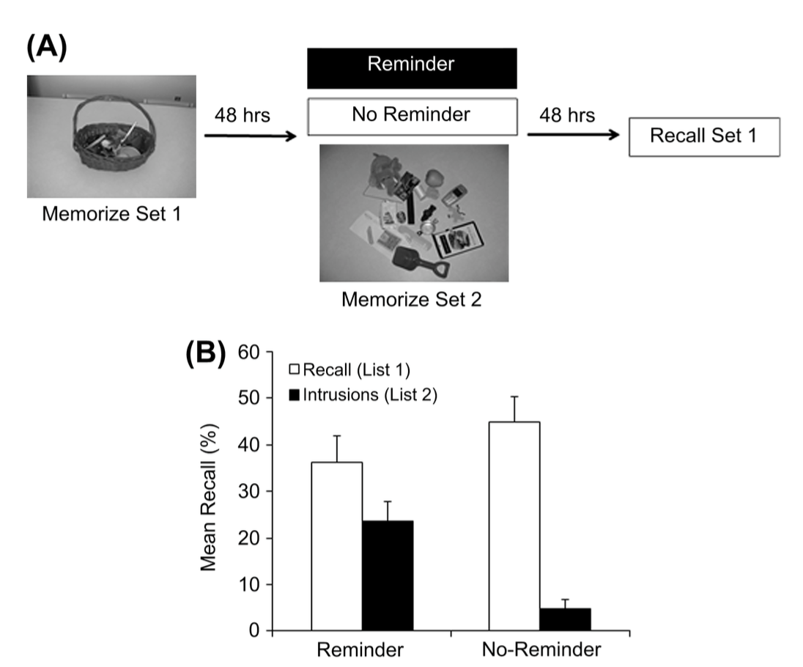
Hupbach et al. (2007). Learning and Memory, 14, 47

Slide 24
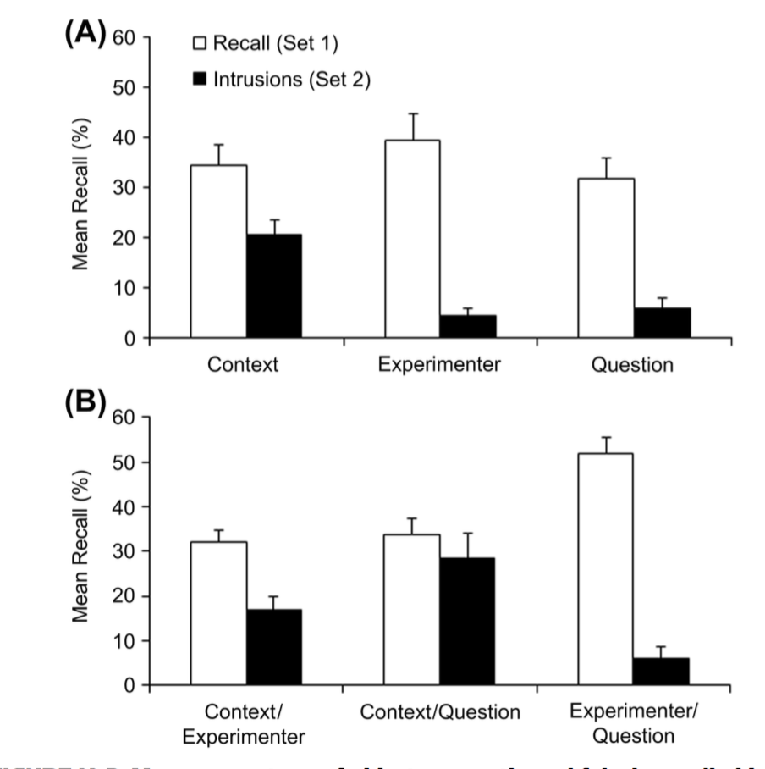
Hupbach et al. (2008). Learning and Memory, 15, 574

Slide 25
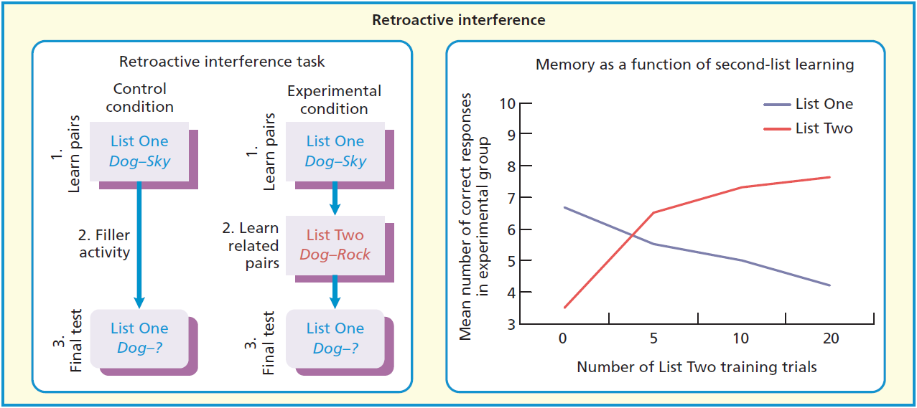
Barnes & Underwood (1959). JEP, 58, 97

Slide 26
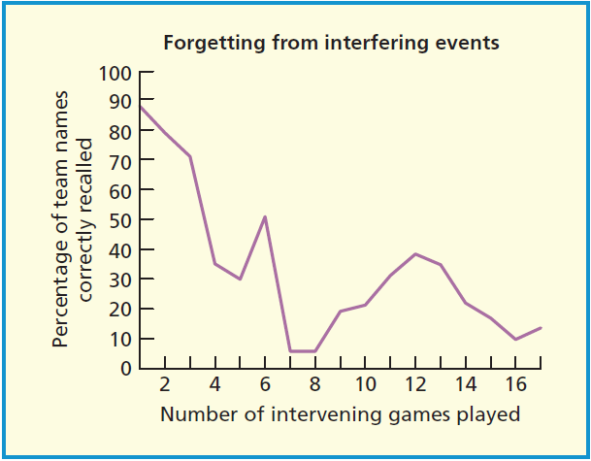
Baddeley & Hitch. (1977). In S. Dornic (Ed), Attention and Performance. Hillsdale, NJ: Erlbaum

Slide 27
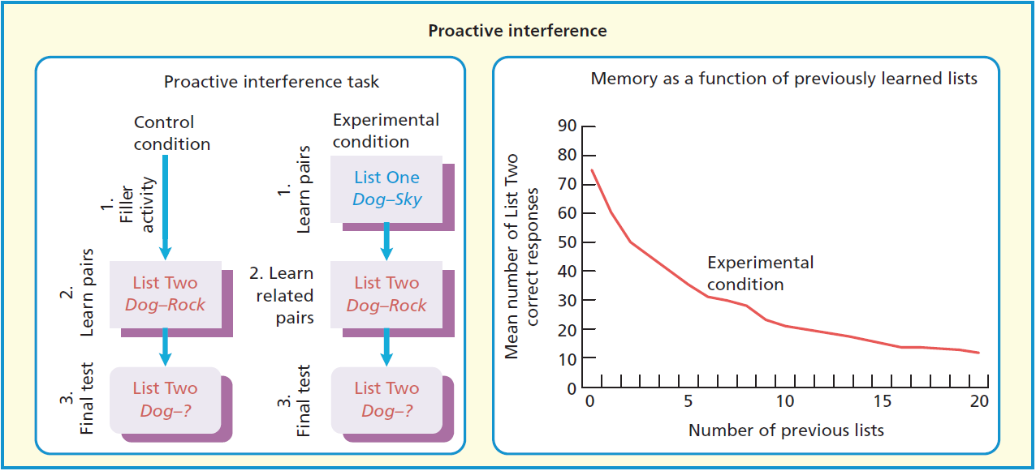
Underwood (1957). Psychological Review, 64, 49

Slide 28
Keppel & Underwood (1962). Journal of Verbal Learning and Verbal Behavior, 1, 153

Slide 29
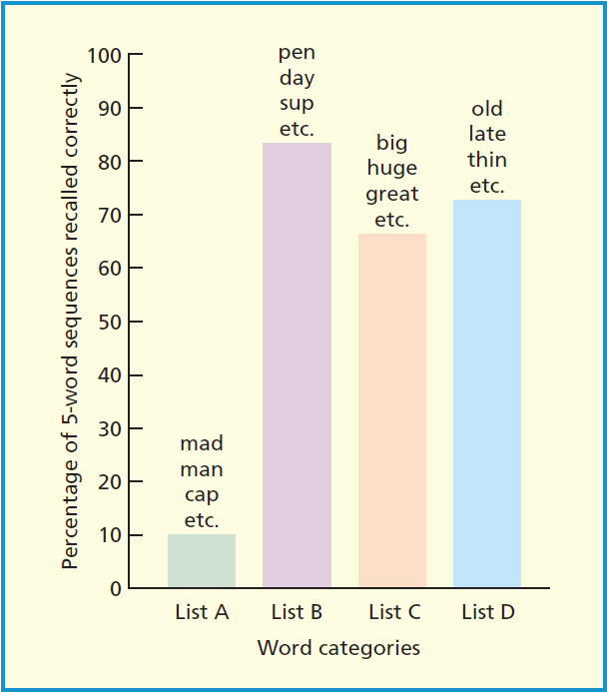
Baddeley (1966). Quarterly Journal of Experimental Psychology, 18, 362

Slide 31
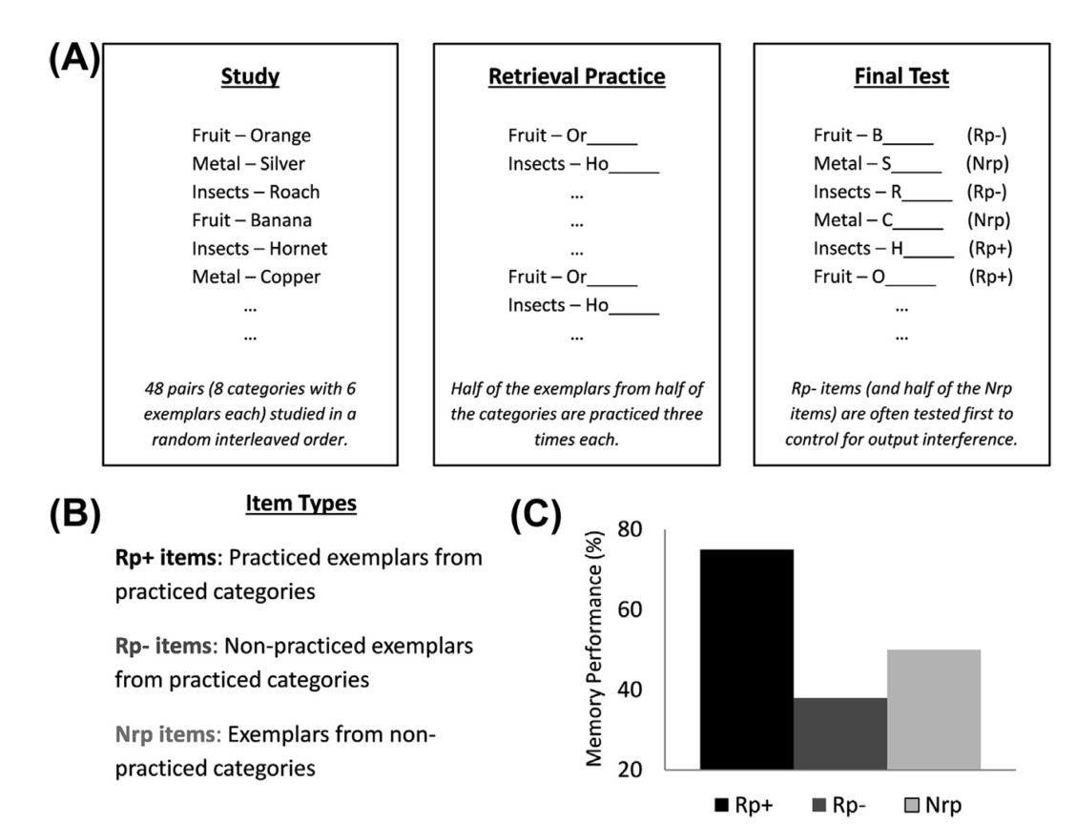
Anderson et al. (1994). JEP: Learning, Memory and Cognition., 20, 1163

Slide 32
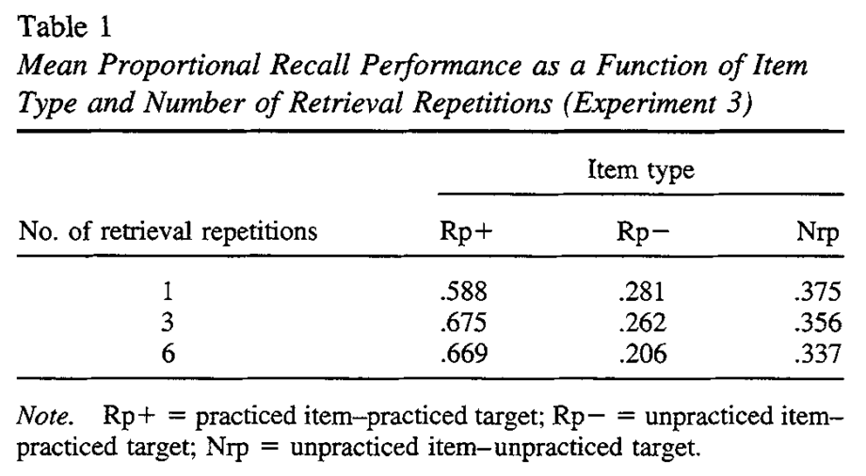
Macrae & MacLeod (1999). Journal of Personality and Social Psychology, 77, 463

Slide 33
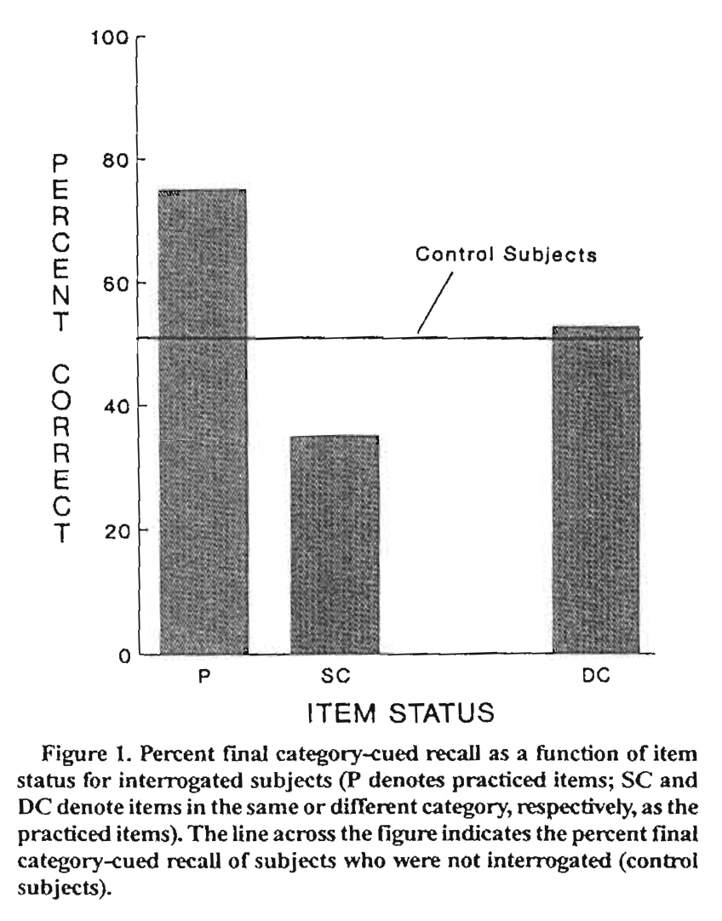
Shaw et al. (1995). Psychonomic Bulletin and Review, 2, 249

Slide 34
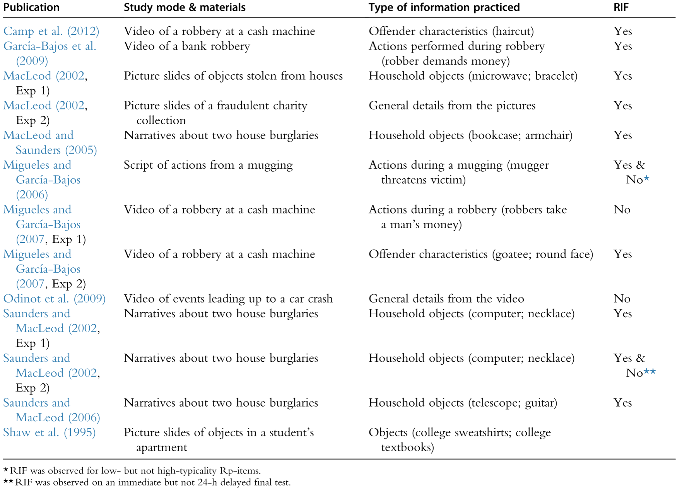
Storm et al. (2015). In The Psychology of Learning and Motivation (Vol. 62), pp. 141-194.

Slide 35
Linton (1975). In Norman & Rumelhart, Explorations in cognition.

Slide 36
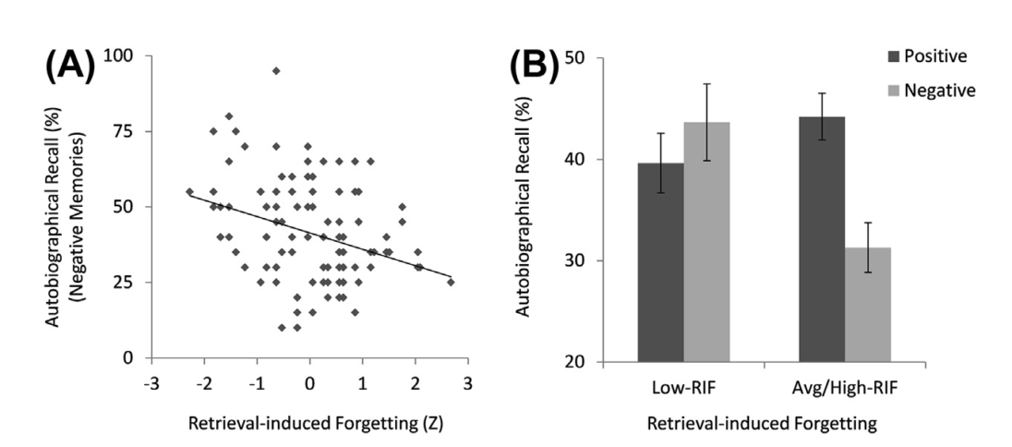
Storm & Jobe (2012). Psychological Science, 23, 1356

Slide 37
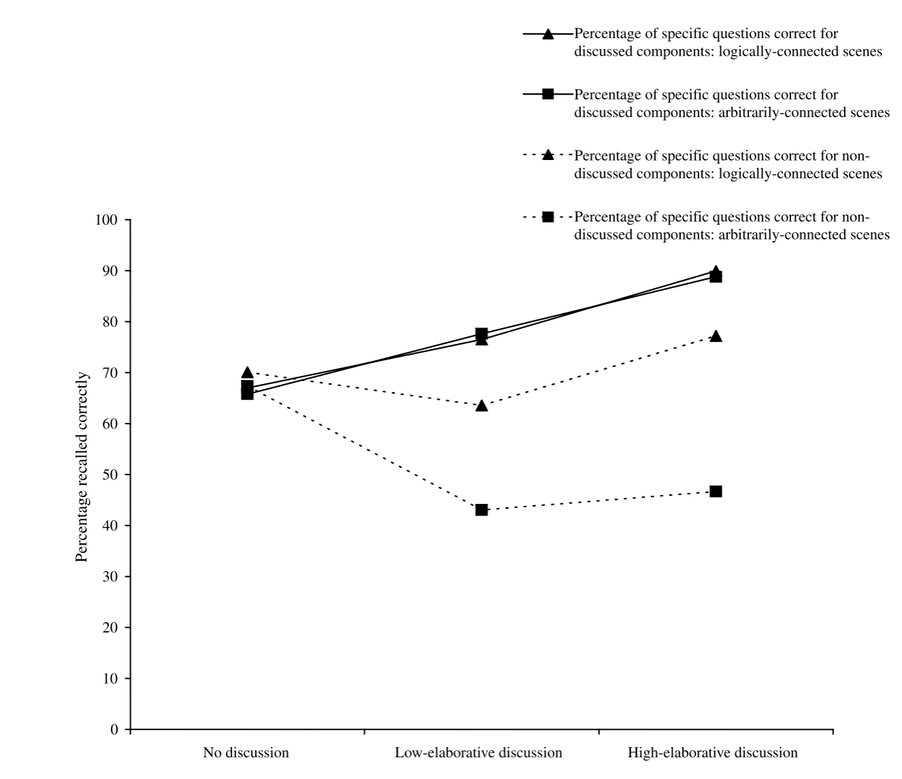
Conroy & Salmon (2006). Journal of Experimental Child Psychology, 95, 278

Slide 38
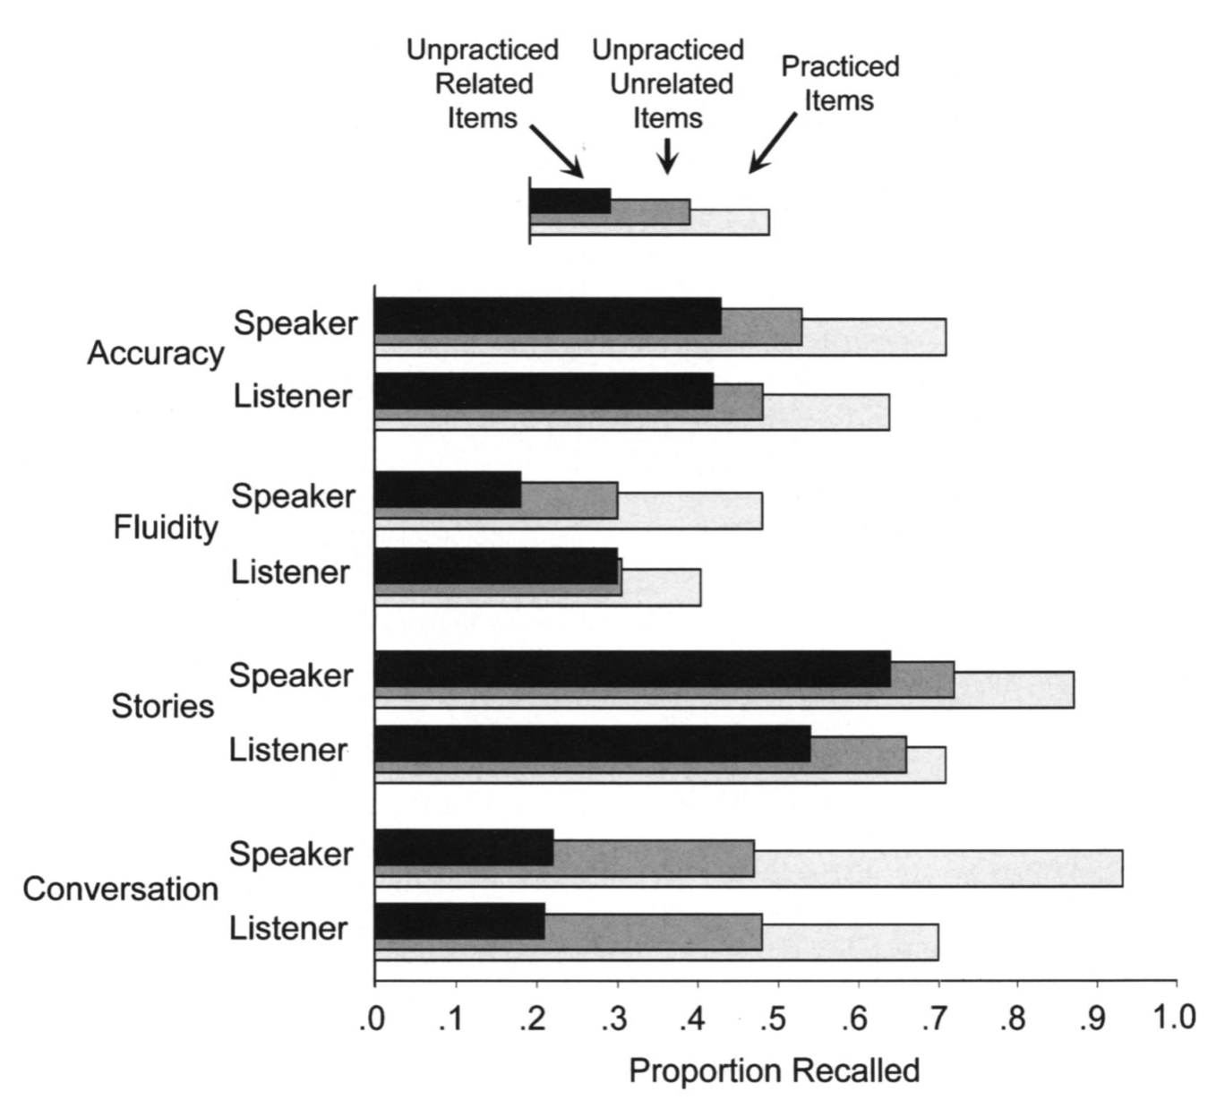
Cuc et al. (2007). Psychological Science, 18, 727
Notes:
Retrieval specificity: Simply studying the material is not sufficient to trigger RIF despite the fact that it strengthens the event restudied (not an interference effect)

Slide 39
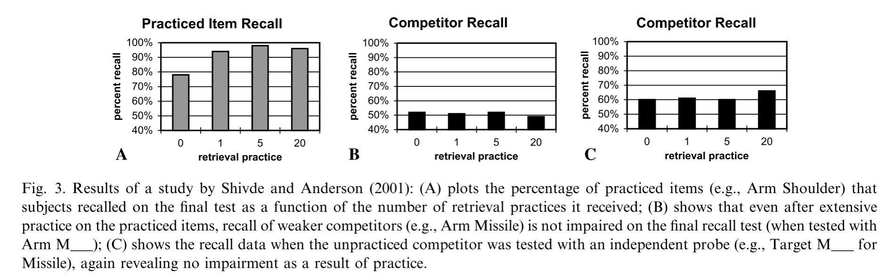
Shivde & Anderson (2001).In D.S. Gorfein (Ed), On the Consequences of Meaning Selection (pp. 175 190)
Notes:
Anderson et al (1994) Phase 2 of RIF paradigm used probes not belonging to the studied material. It still lead to RIF

Slide 40
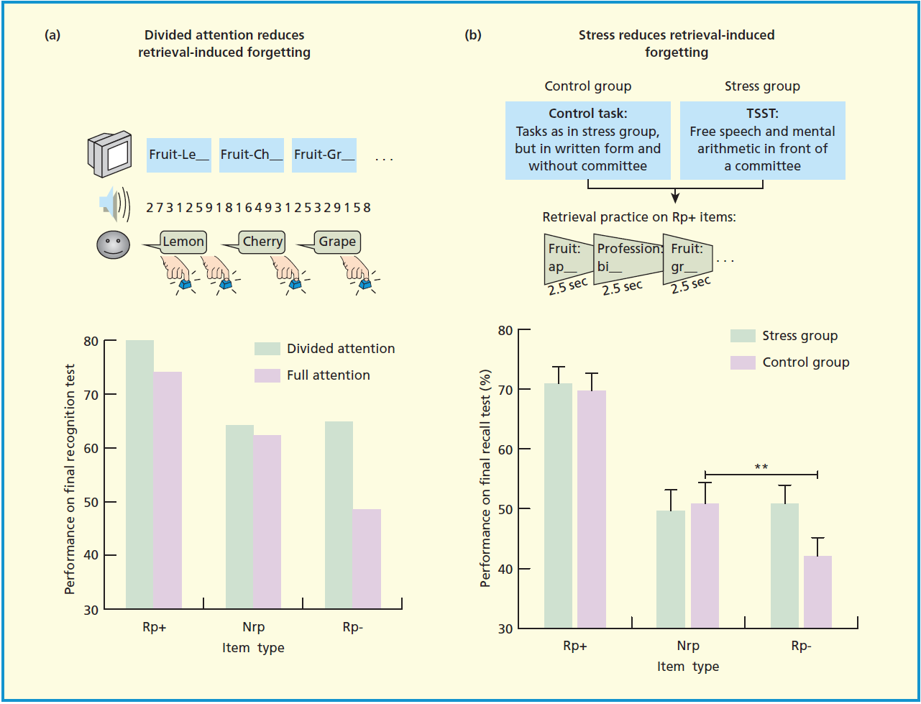
Roman et al. (2009). Psychological Science, 20, 1053
Koessler et al. (2009). Psychological Science, 20, 1356

Slide 41
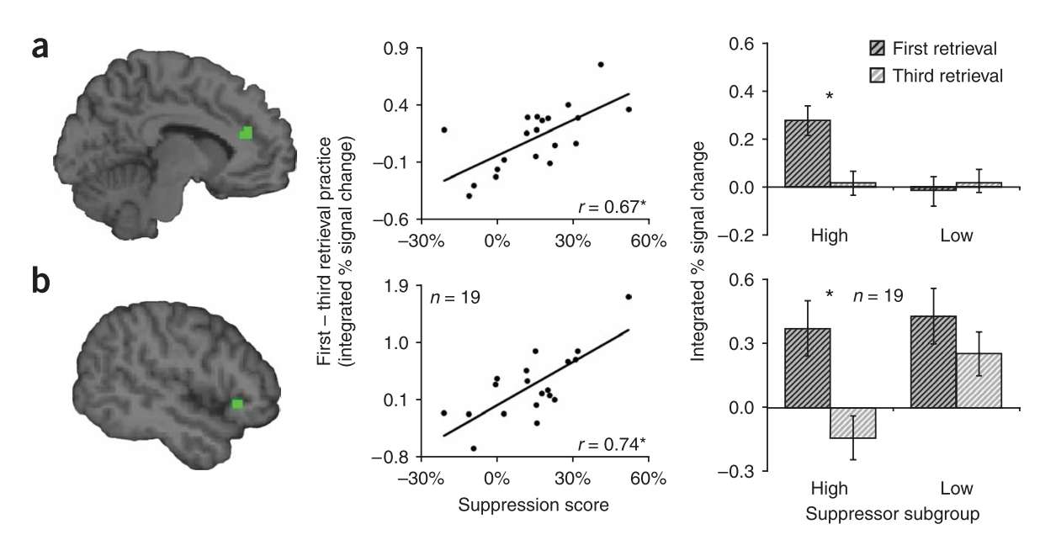
Kuhl et al. (2007).Nature Neuroscince, 10, 908
Notes:
Reduced RIF in

Slide 42
Storm & Jobe (2012). Psychological Science, 23, 1356

Slide 43
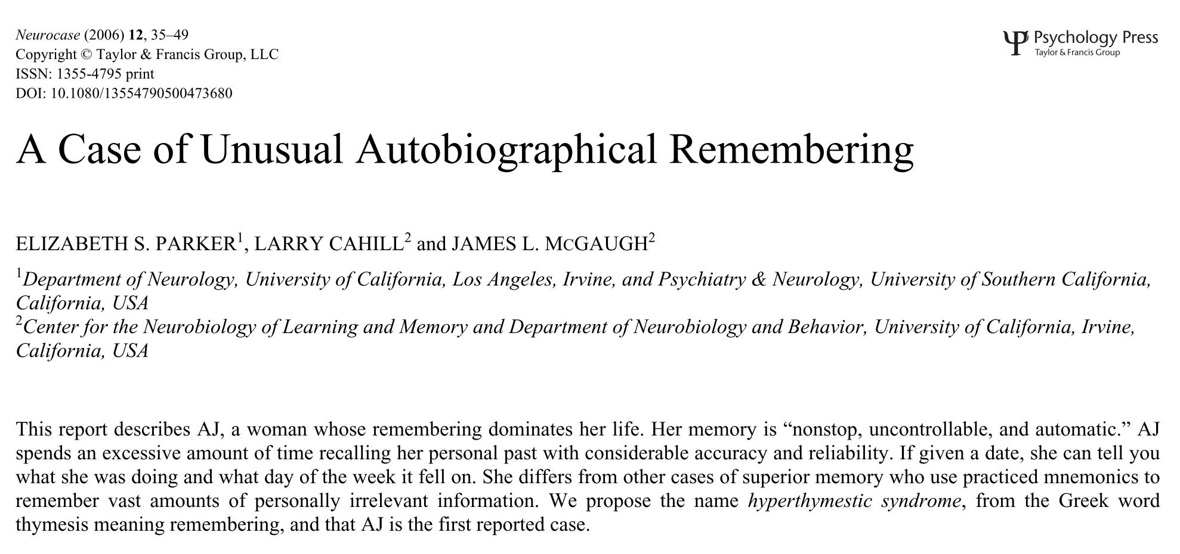

Slide 44
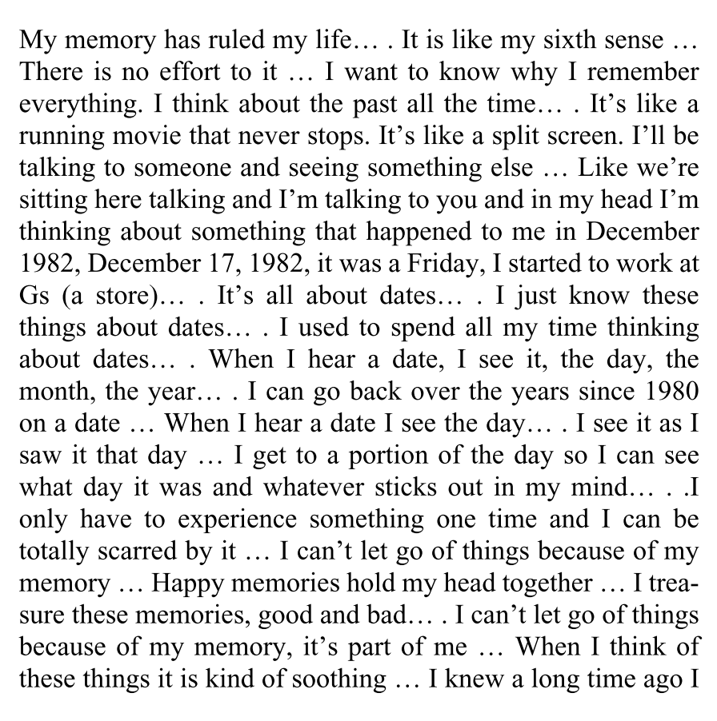
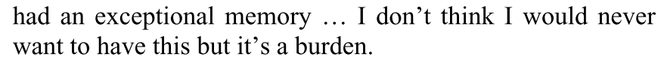
Jill Price

Slide 45
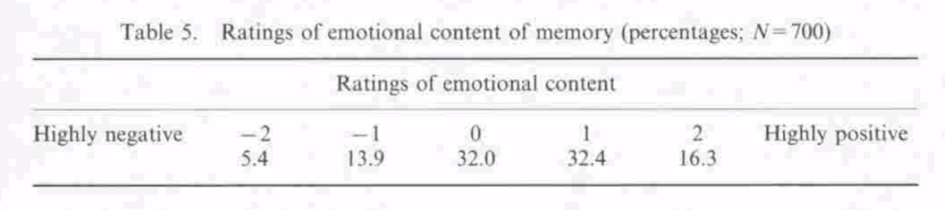
Diener et al.(2018). Perspectives onPsychological Science, 13, 166
Notes:
A research by Diener et al. (2018) based on a sample of more 1 million individuals from 166 nations found that a majority of people (74%) reported more positive feeling yesterday than negative ones (only 47% found that their life fulfilling). Many other studies have found that people remember mostly pleasant events. For instance, Bernstsen (1996) asked participants to write spontaneous memory in a diary over a long period of time. One of the results of this study, shown in Figure 1 is that most of those spontaneously occurring memory were positive (49%) vs. 32% neutral and barely 19% aversive.

Slide 46
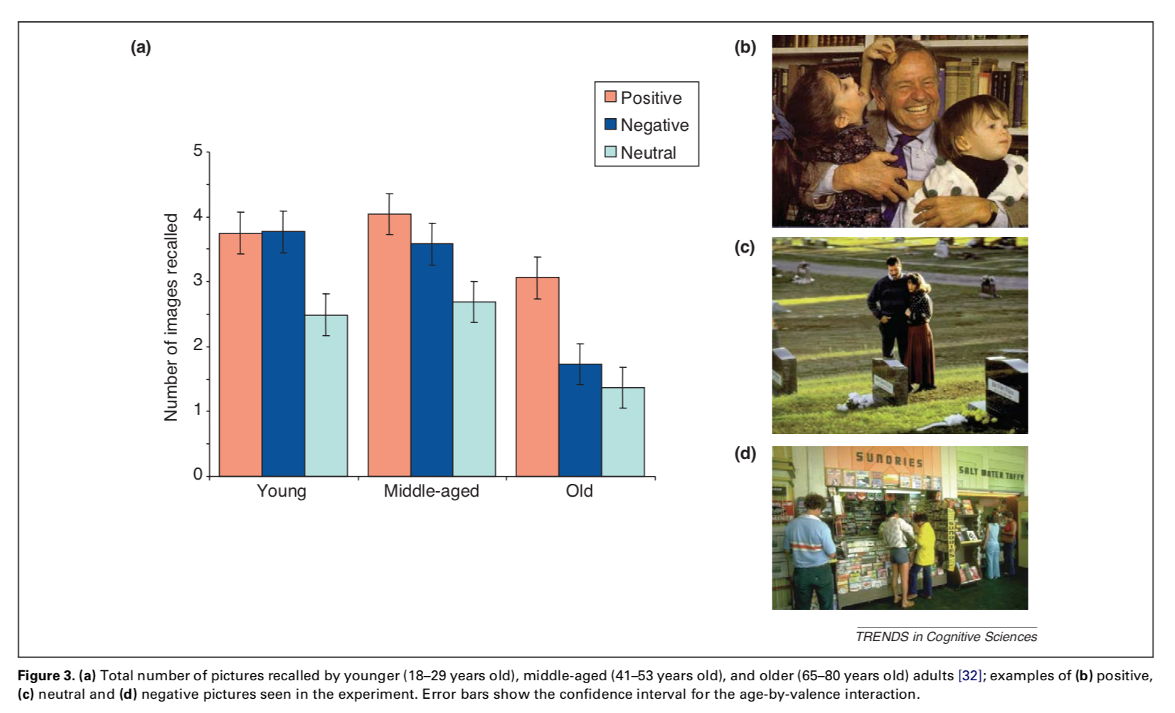
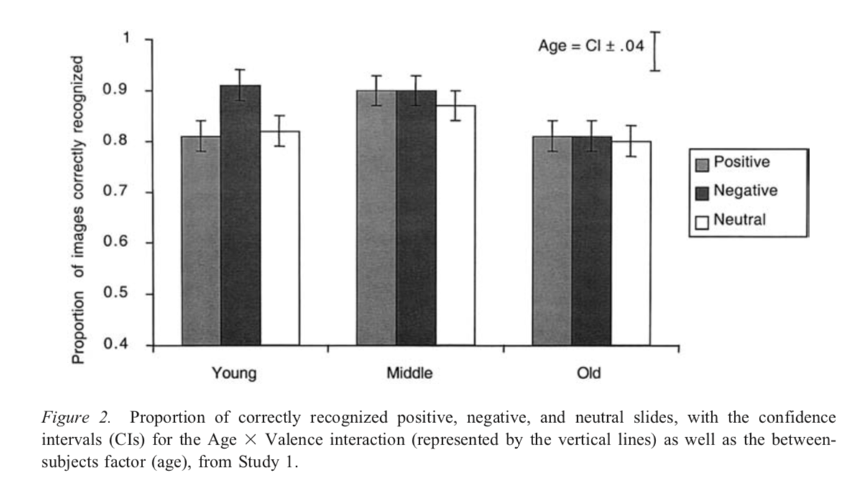
Charles et al.(2003). Journal of Experimental Psychology: General, 133, 310
Notes:
Maybe this is just because most events in a person life are happy. Or maybe there is a bias to remember the past through rose-tintered glasses and to selectively retrieve positive events. Typical of these results is a study by Charles et a. (2003) in which participants were shown 32 scenes whose emotional valence varied (positive, neutral, negative). They were then asked to remember as many as possible. As shown in Figure 2, emotional picture were better remembered than neutral ones but, as participants got older, they selectively remembered the positive events better. A subsequent recognition test show that these results is due to a selective retrieval of the positive memories as otherwise, the emotional valence had no impact on the rate of recognition.

Slide 47
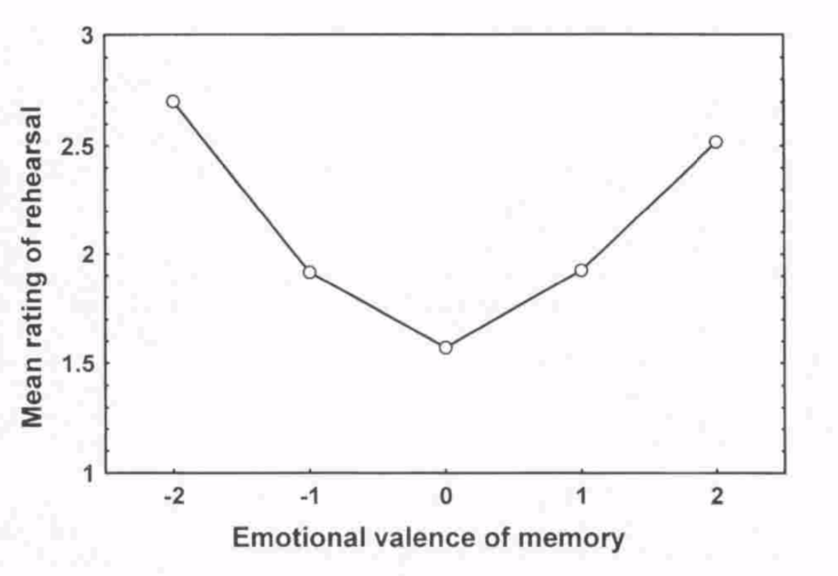
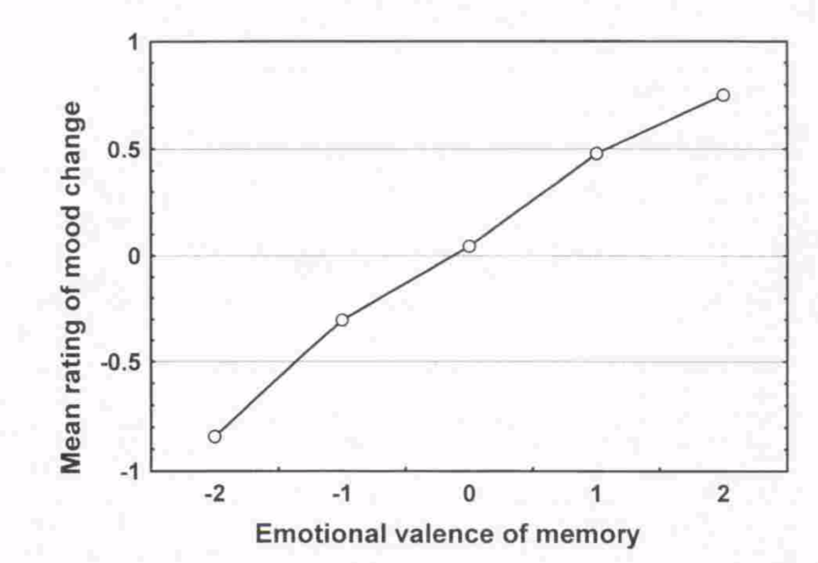
Berntsen.(1996). Applied Cognitive Psychology, 10, 435
Notes:
What explains this effect? Maybe positive events are rehearsed more often and that would explain the effect though data from the study by Bernsten showed that emotional memories were more often rehearsed than neutral ones, no matter their valence. Maybe positive memories are more richly integrated with other memories, leading to a better retrieval as they are many more paths through the memory network leading to them. Or maybe there are processes actively inhibiting the retrieval of unpleasant memories, because of the emotional impact they could have on the individual. The study by Bernsten showed, for instance, that the valence of a retrieved memory had an impact of the mood of the individual. For instance, in a study by Sedikides & Green (2000), participants passed a “personaility test” which then allowed to predict their behavior (of course, there was no test and the prediction were the same for all participants). Some of these behavior were whatthe authors called “central” behavior, which are strongly revealing of one’s personality (“You would make fun of others because of their look”) and others which were peripheral. The behavior were either good or bad. After a distraction task, they were then asked to recall as many behavior predicted as possible. The recall information was compared to a control condition where the behavior were predicted of someone else. As Figure 3 shows, there is a bias toward a better remembering of the positive prediction when they were about key personality trait. The authors interpretation is that this bias reflects a protection mechanism which allows an individual to keep a positive image of himself by selectively remembering only positive information about himself. This process, when brought to its extreme, could explain cases of psychogenic amnesia or repression of traumatic memories such as childhood trauma which Freud had claimed to observe in his patients. This chapter is devoted to that question.

Slide 48
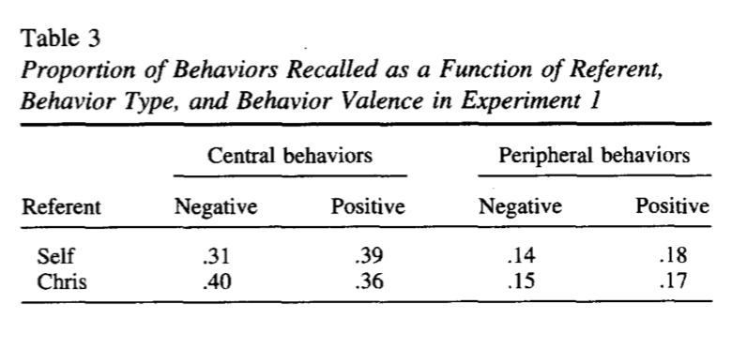
Sedikides & Green.(2000. Journal of Personality and Social Psychology, 79, 906

Slide 49
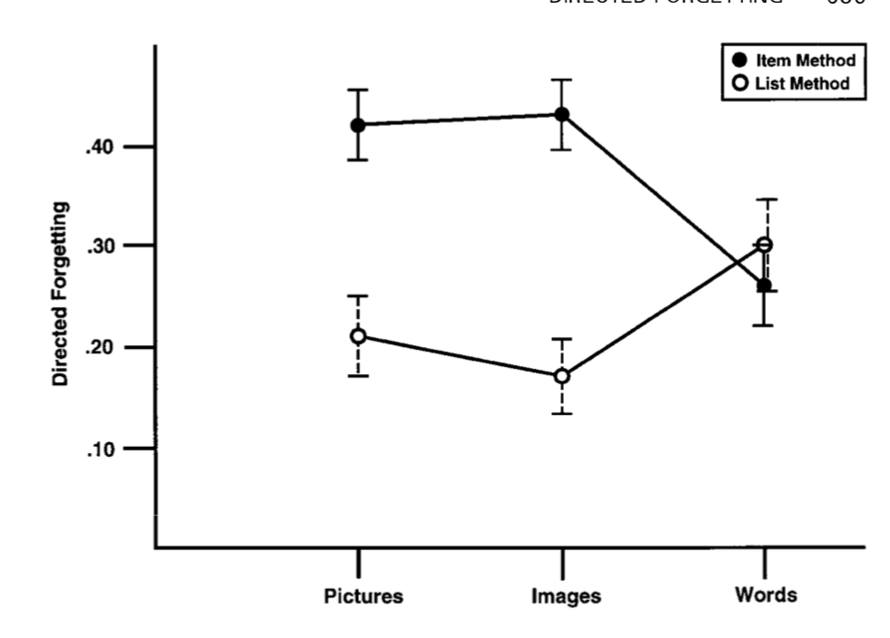
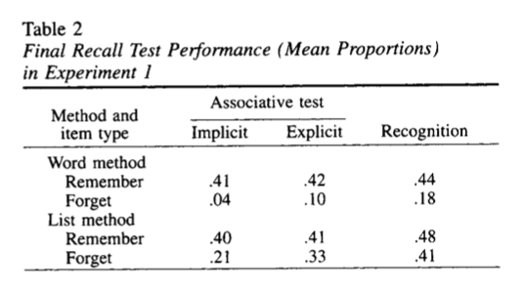
Besden & Besden (1996).Memory, 4, 633
Basden et al. (1994). Journal of Experimental Psychology: Learning, Memory, & Cognition, 19, 603
Notes:
How could an individual control forgetting? There is several hypothesis: you could impair encoding; you could suppress retrieval, either by avoiding pertinent retrieval cues or maybe by not allowing those cues to trigger the relevant memory, a form of retrieval suppression. Let’s examine each of this hypothesis one by one.
a method called item-method directed forgetting. The subject is presented with a list of item that he will have to recall later but after some item, he is given an instruction to forget it as he will not be tested on it later. This simple manipulation (forget about it) has an impact on remembering. Figure 5 shows data from one of the may study using this method (only look at the item method line). It shows the decrease in recall for the to-forget items relative to the not-to-forget items for different types of materials (pictures, images, words). There is a clear effect of the manipulation.

Slide 50
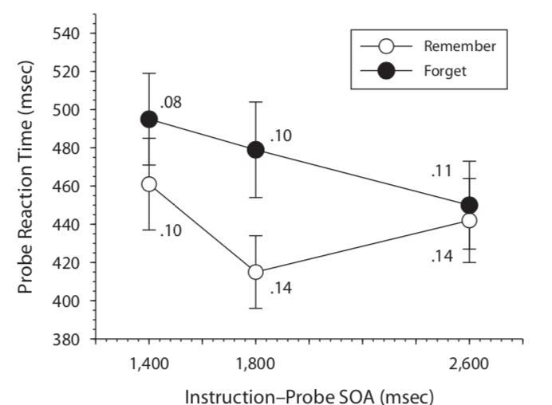
Fawcett & Taylor.(2008). Memory & Cognition, 36, 1168
Notes:
Moreover, it seems that the impact is on encoding, not on retrieval. The criteria used by this research is that if an effect remains the same in free recall and in recognition, the impacted process is encoding while if the effect disappears in a recognition procedure, than the information must have been encoded even though it is available for retrieval. The former is the case for item-method directed forgetting. This perfectly illustrated by a study by Basden, Basden, & Gargano (1993) shown in Figure 5: as can be seen, the recall of the item marked to be forgotten is equally impaired both in a paired associate task and in a recognition task.

Slide 51
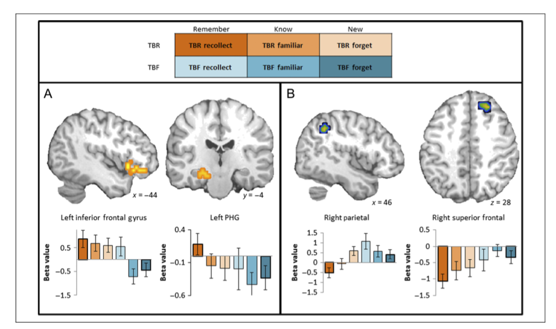
Rizzio & Dennis .(2013). Journal of Cognitive Neuroscience, 25, 297
Notes:
Directed forgetting in this case could hence be due to the fact that the individual stops encoding once the to-be forgotten instruction is given, for instance, by stopping elaborative rehearsal. But recently, some researchers have entertained the possibility of an active “encoding suppression” process: encoding would not simply be stopped but actively inhibited. The idea is derived from results such as those by Fawcett & Taylor (2008). Data from one of their study is shown in Figure 6. It is a classic item-based directed forgetting paradigm but with a double-task added on top of it: an asterisk appearing on the screen after the remember/forget instruction indicated to the participants that they had to press button as fast as possible. The reaction time to press the button was recorded and used a criterion for attentional resources dedicated elsewhere. As can be seen, the reaction time was longer after the forget instruction. They interpreted this result as the fact that attentional ressources were used to suppressing encoding. Consistent with this interpretation, recent fMRI study (for instance, Rizio & Dennis, 2013) have shown that areas associated with cognitive control (in the prefrontal cortex) are more activated in instances of successful intentional forgetting than in cases of successful intentional remembering (Figure 7).

Slide 52
Besden & Besden (1996).Memory, 4, 633
Basden et al. (1994). Journal of Experimental Psychology: Learning, Memory, & Cognition, 19, 603
Notes:
A variant of the item-based directed forgetting method is the list-based directed forgetting one. In this case, the participants is told to learn items from two lists but then he is told that he will only be tested on one. This is a trick: he is then asked to recall items from both lists. As Figure 5 shows (from the same study by Basden & Basden, 1996 we already studied), this method indeed produces selective forgetting of the list the participant was told not to remember. Compared to the item-based version of the task, we are sure that the level of encoding was similar for both lists so that any subsequent deficit in remembering is necessarilty a consequence of retrieval. Indeed, as shown in Figure 5, the deficit in remembering items from the to be-forgotten list disappears in a recognition test.

Slide 53
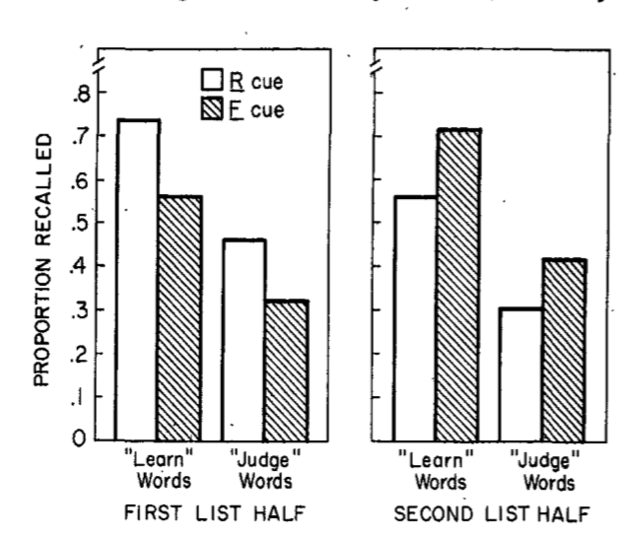
Geiselman et al .(1983).Journal of Experimental Psychology: General, 112, 58
Notes:
But there’s more: items from the to-be forgotten list are not only not as well remembered, there also interferes less with things that needs to be remembered. Figure 8, for instance, show some classic results from a study by Geiselman et al. (1983). It used a classic list-based directed forgetting paradigm. Focus on the “Learn”condition first. As can be seen, the instruction to forget had an impact on the recall of the first list but also on the second list! Basically, when participants were asked to forget the first list, that list was less able to interfere with the second list. But its influence can still be felt as illustrated by a subsequent study by Bjork & Bjork (2003).

Slide 54


Bjork and Bjork (2003).Journal of Experimental Psychology: Learning, Memory, and Cognition, 29, 524

Slide 55


Joslyn & Oakes (2005).Memory & Cognition, 33, 577
Notes:
A study by Joslyn & Oakes (2005) illustrates that this kind of effect can also be obtained with more natural materials. Students were involved in a study in which they had to record for 2 weeks 10 events in their life in a diary. At the end of the first week, students in the forget group were told to forget about what they had recorded as they would not be tested on it (the material would be use for another study) while the remember group were told to continue recording the events (this is the intentional condition depicted above. I won’t talk about the incidental condition as I’m not convinced by the manipulation). Then after two weeks, the participants were tested on all the events. As can be seen, the two groups do not differ for the event of the second week but differ for the ones of the first week (note: the demonstration would have been more efficient if this had been counterbalanced). Interestingly, the emotional valence of the memory of the intensity of the event do not have an impact on the effect.
This kind of effect has been explained either by an active inhibition of the forgotten item induced by the to-forget instruction (retrieval inhibition hypothesis) or by the fact that the to-forget instruction induce a “context shift” by creating two different context (one linked to the remember instruction, the other to the not remember instruction) with the “remember” instruction at test specifically activating the “remember” context. The experimental arguments in favor of one hypothesis or the other are, in my opinion, utterly unconvincing. The only thing that can be said is that change in context is one method that people often use explicitly to avoid retrieving some memories. The goal is obviously to avoid being confronted to retrieval cues that would trigger the automatic recovery of unwanted memories. On the other hand, other experimental works bring strong support for the existence of an active retrieval suppression process, similar to the one suspected to play a role in retrieval-induced forgetting.

Slide 56


Levy & Anderson (2008).Acta Psychologica, 127, 623

Slide 57


Noreeen & MacLeod (2013).JEP: LMC, 39 375

Slide 58


Anderson et al. (2004), Science, 303, 232

Slide 59



Depue et al. (2007), Science, 317, 215

Slide 60


Benoit & Anderson. (2012), Neuron, 76, 450

Slide 61

Benoit & Anderson. (2012), Neuron, 76, 450

Slide 62

Kritchevsky et al.. (2009), Journal of Cognitive Neuroscience, 22, 602

Slide 63



Wheeler (1995), JEP: LMC, 21,173

Slide 64


Erdelyi & Kleinbard (1995), JEP: HLM 4,275
Bluck et al. (1999). Psychology and aging, 14, 671

